Slide 1
Day 4: Deploying and improving your assistant using Rasa X

Slide 2
RASA CERTIFICATION WORKSHOP
Agenda
Day 1: Deep dive into NLU and dialogue management with Rasa Open Source
Day 2: Create an MVP assistant, end-to-end testing, DIET architecture, and TED policy
Day 3: Adding custom actions and implementing forms
Day 4: Deploying and improving your assistant using Rasa X
Day 5: Recap + Q&A Panel

Slide 3
RASA CERTIFICATION WORKSHOP
How to get help
Please ask your questions in the #workshop-help Slack channel rather than the Zoom chat. Slack is the place the Rasa team will be monitoring most closely.
Karen, Mady, and Juste will be in Slack answering questions, as well as Arjaan, Ella, and Greg from our Customer Success Engineering team
Monday - Thursday the Rasa team will be dedicating time to answering your questions in Slack from 4pm - 6:00 pm Central European Time
Feel free to ask questions outside of these hours, but responses may be a little slower
A note on time zones:
The Rasa team is based across the US and in Berlin. We’ll do our best to answer questions within team members’ working hours, but please keep in mind, some discussions may need to take place async rather than in real time.

Slide 4
Review
What we’ve set up for today...
The Rasa team has provided a virtual machine on Google Cloud Platform and installed Rasa X.
Check your Slack DMs for Rasa X login details and the URL to access the server
Go ahead and make sure you can log in and access the server via SSH
You have built a minimum viable assistant this week
Thanks Mady & Juste!
The rest of the other things we will need are in place
financial-demo repo on GitHub - forked to your personal account
Telegram account ready to go

Slide 5
Agenda
Today’s theme: deployment and production
Lecture/Instructor Demo: setting up the server
Deployment overview
Install Rasa X & Apply domain and SSL
Code along: Finish up deployment
Load assistant into Rasa X
Get action server and duckling working
Connect to external channel
Lecture: Introducing Rasa X
Why Rasa X
How to use Rasa X as your development progresses
Instructor Demo: Development workflow
Review conversations
Moving changes to production

Slide 6
Setup
Sync your fork with the upstream repository
Pull in the latest changes from upstream. This pulls in a recent update that makes the Financial Demo assistant compatible with Rasa Open Source 1.10.0.
Fetch the latest branches and commits from upstream (if you get an error saying no upstream found, run git remote add upstream https://github.com/RasaHQ/financial-demo.git and then re-run the fetch command)
git fetch upstream
Checkout your local master branch
git checkout master
Merge changes from upstream/master into your local master branch
git merge upstream/master
Push changes to your remote repository
git push origin master

Slide 7
Deployment

Slide 8
Deployment
Deployment Overview
What do we mean when we say ‘deployment’?
Until now, we’ve been building and testing the assistant on our local machines.
When we deploy, we’ll push the code to a remote server and make the application accessible to users through a live messaging channel integration (Telegram)
👩‍💻
Local Dev
💻
🌐
Server

Slide 9
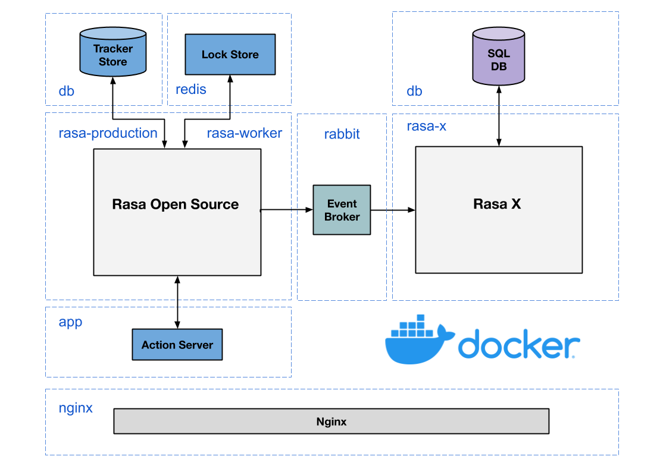
Deployment
What are we deploying?
Notes:
Nginx - reverse proxy and load balancer
Kubectl get pods

Slide 10
Deployment
Deployment options
Kubernetes (k8s or k3s)
Runs multi-container applications on multiple host machines (nodes)
Pod = smallest deployment unit (can be single or multiple containers).
Copies of pods are distributed on nodes. The number of copies you want is defined by the deployment.
If one node goes down, the k8s service creates more pods to maintain the desired number.
Advantages: resilient, can be configured to auto-scale
Docker Compose
Runs multi-container applications on a single host machine
Networks containers together
Recommended for development or for smaller deployments

Slide 11
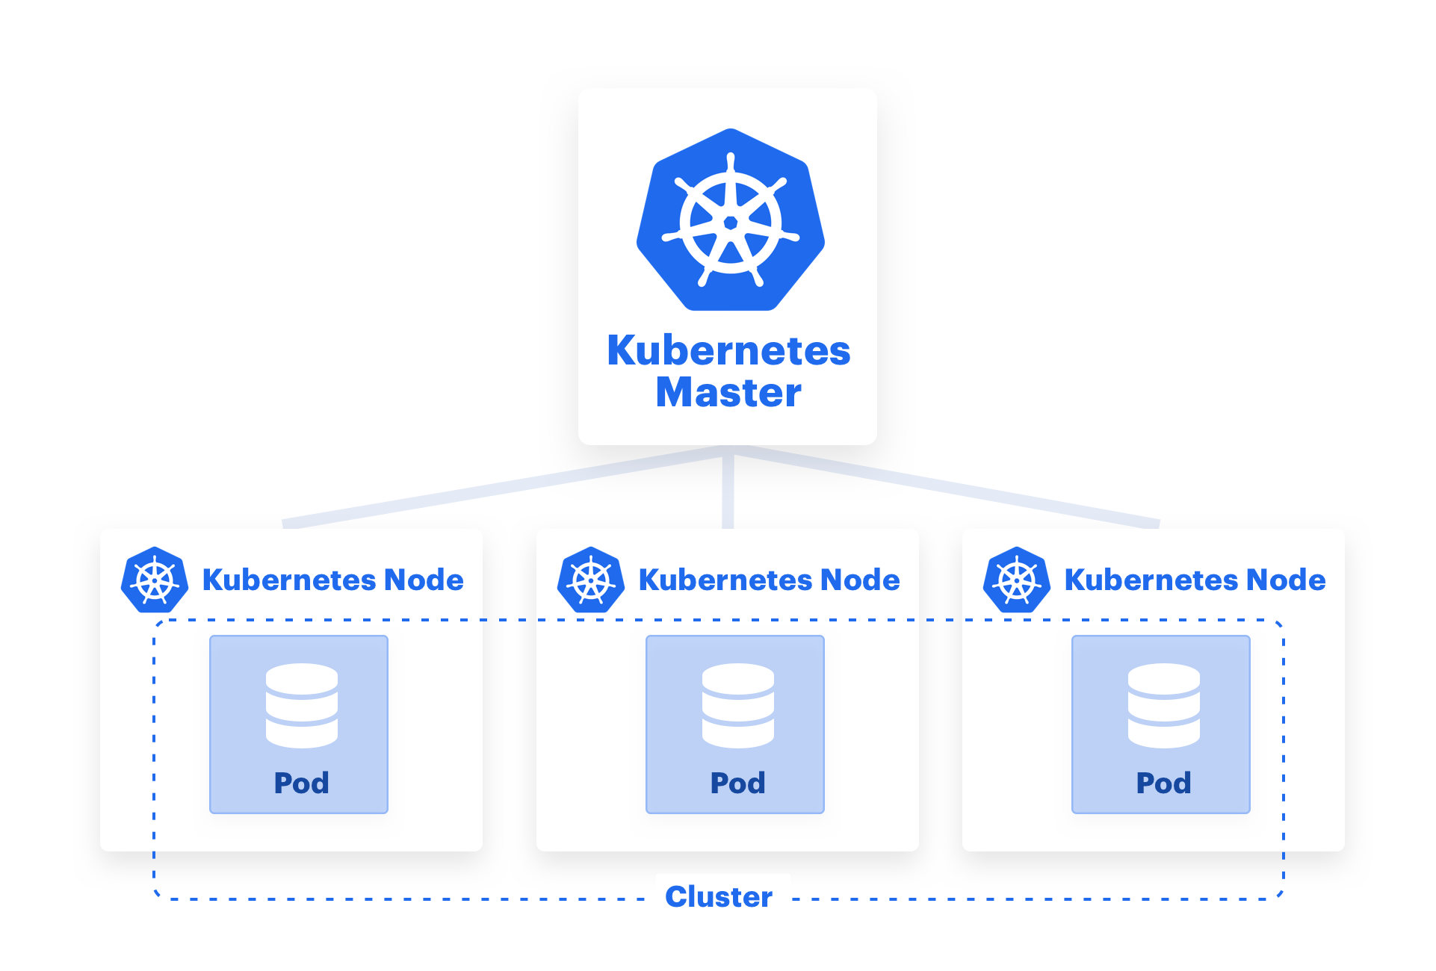
Deployment
Kubernetes (super high level architecture)

Slide 12
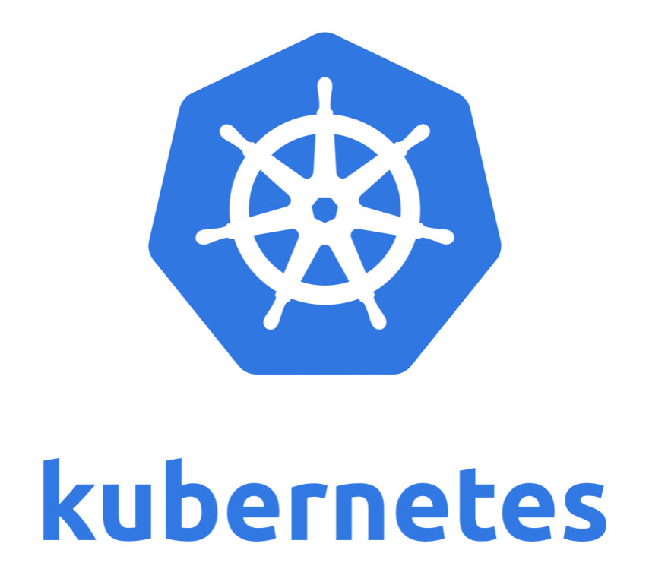
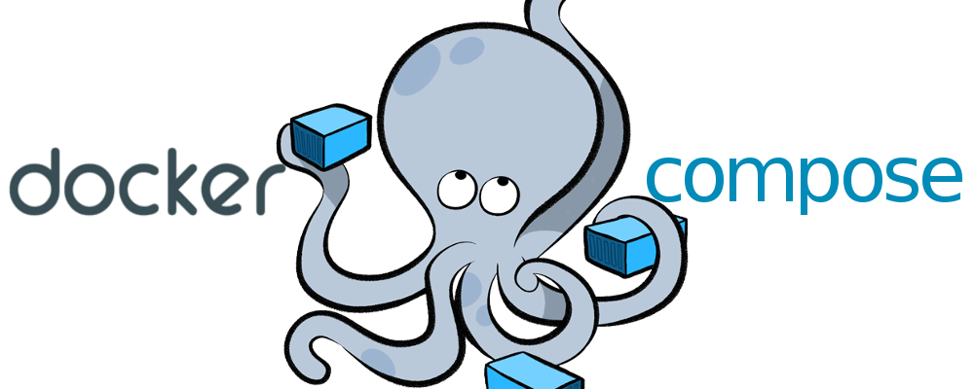
Deployment
Which deployment option should you choose?
(manual install)
Complexity to set up and manage
One-line Deploy Script
Application scalability and reliability

Slide 13
DEPLOYING RASA X
One Line Deploy Script
curl -s get-rasa-x.rasa.com | sudo bash
Can deploy Rasa Open Source/Rasa X to a Kubernetes cluster you’ve already created, or it can create one for you. If you use the script to create your cluster, it spins up a k3s cluster. (k3s = lightweight version of Kubernetes)
What the script does:
Checks for an existing cluster. If it doesn’t find one, it creates one.
Installs Helm (Helm = package manager for Kubernetes)
Deploys Rasa Open Source and Rasa X using the Rasa X Helm Chart
💡 Tip: to upgrade your Rasa X version, just re-run the deploy script. It’ll automatically upgrade to the latest version
Blog post: The Complete Guide to Deploying your Rasa Assistant

Slide 14
Demo

Slide 15
Deployment
In this Demo...
This demo will show you the steps the Rasa team took to set up your server for the workshop. This part won’t be interactive (nothing to follow along with here - we’ve already set this up for you). But feel free to watch and ask questions!
Create a new virtual machine on Google Cloud platform
Apply a domain
Install Rasa Open Source and Rasa X using the one-line deploy script
Apply an SSL

Slide 16
Integrated Version Control

Slide 17
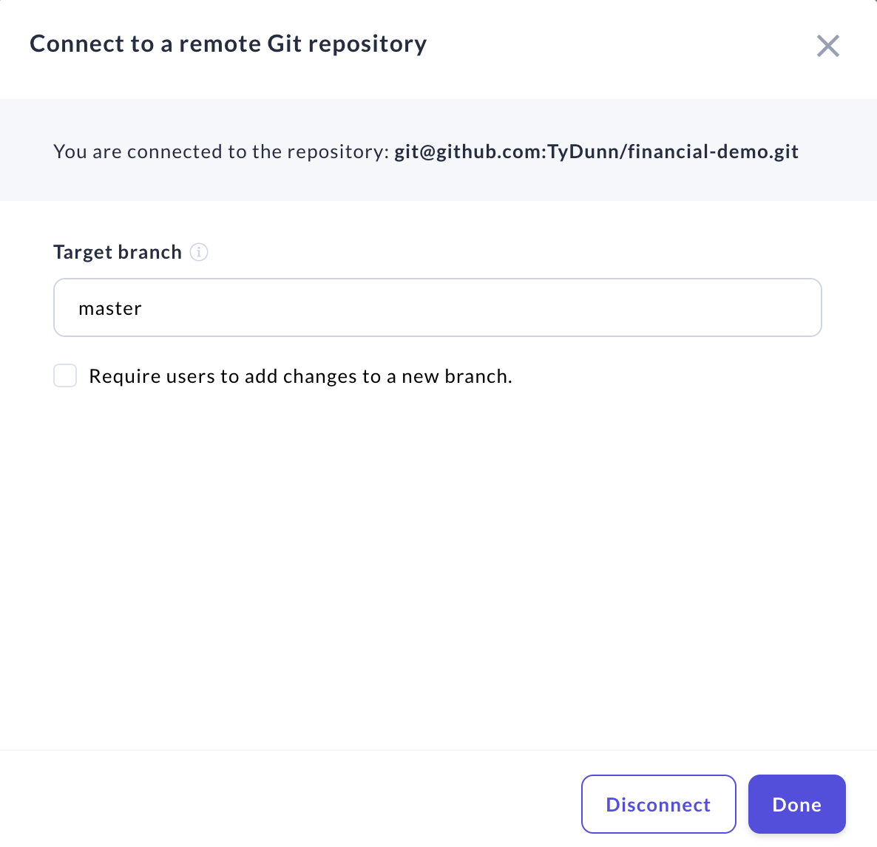
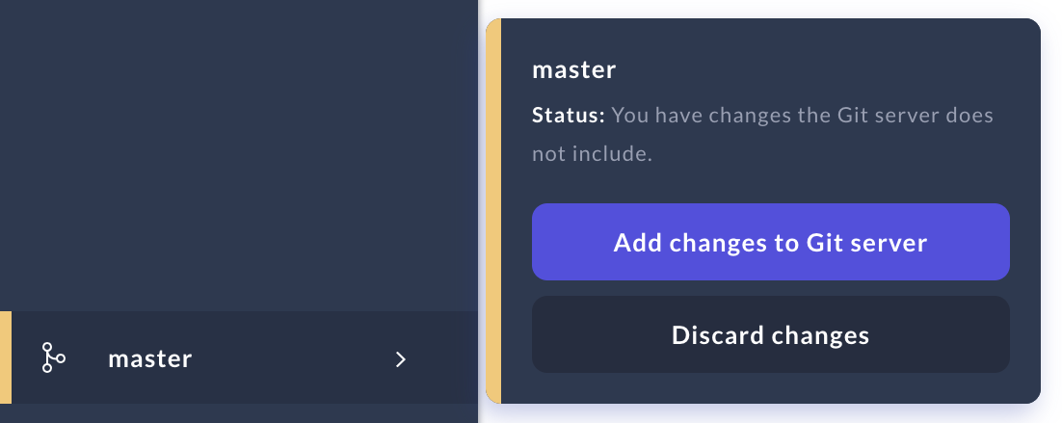
LOAD IN YOUR ASSISTANT
Integrated Version Control
What does it do?
Creates a two-way sync with a remote git repository (woks with any git-based platform: Bitbucket, GitHub, Gitlab, etc.)
Allows you to version training data and push changes made in Rasa X to a target branch
By extension…
Connects Rasa X to downstream workflows like automated testing and deployments
Brings Rasa X in line with software engineering best practices
Notes:
Add screenshot UI Setup

Slide 18
INTEGRATED VERSION CONTROL
Connect your assistant to Rasa X
Navigate to your forked copy of the Financial Demo assistant
Copy the SSH URL from your GitHub repository
Connect Integrated Version Control in Rasa X
Specify the branch you want to use as master
Copy and paste the Deploy Key in your GitHub repository settings

Slide 19
Finish Deployment

Slide 20
Finish Deployment
What’s left?
Update master branch from upstream repository (RasaHQ/financial-demo)
Set up the action server
Enable Duckling
Connect Telegram

Slide 21
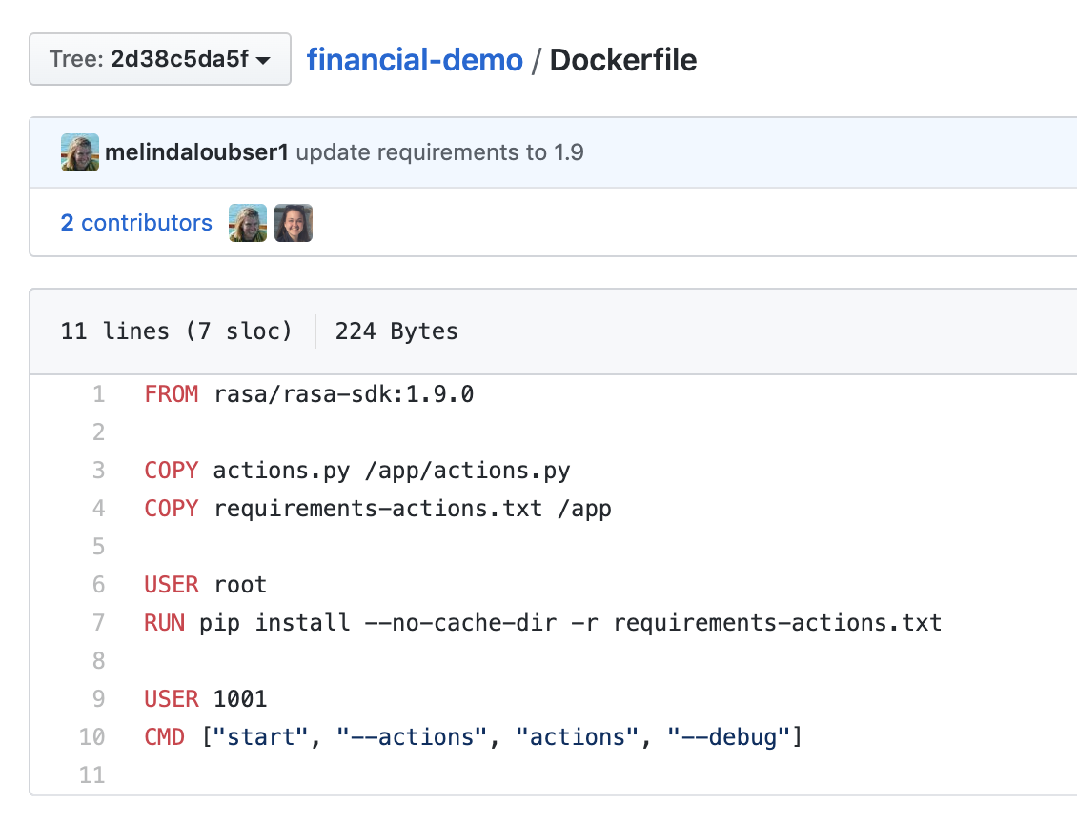
Finish Deployment
Deploying Custom Actions
When it’s deployed, the assistant’s custom action server runs in a container.
A Docker image is a blueprint for containers that are “spawned” from it. It defines the OS and system requirements, and the dependencies the containerized application needs to run.
The Dockerfile contains the instructions for building a Docker image.

Slide 22
Demo:
Building the Action Server Image

Slide 23
Demo: Action Server
Steps for Building the Action Server Image
Place the Dockerfile in the base of your project directory and note the path to your actions.py file.
Run this command in the same directory as your Dockerfile:
docker build . -t <account_username>/<repository_name>:<custom_image_tag>
Push the image to the container registry
Log in (or log in from the Docker desktop app)
docker login --username <account_username> --password <account_password>
Push the image
docker push <account_username>/<repository_name>:<custom_image_tag>
Reference the image in your deployment

Slide 24
Finish Deployment
Deployment Settings
The one line deploy script surfaces the most common deployment settings as environment variables that you can customize. These include variables to set your initial password, connect a messaging channel, install a specific version of Rasa X or Rasa Open Source, and more. We’ll use this method to specify the action server image, enable Duckling, and connect Telegram.
To apply the settings, run the export command to export the variable, and then run the one-line deploy script. 💡 You can use this method on a new or existing cluster (e.g. to upgrade to a new version of Rasa X)
export INITIAL_USER_PASSWORD="my-safe-password"
# -E flag applies environment variables from the current user for `sudo`
curl -s get-rasa-x.rasa.com | sudo -E bash

Slide 25
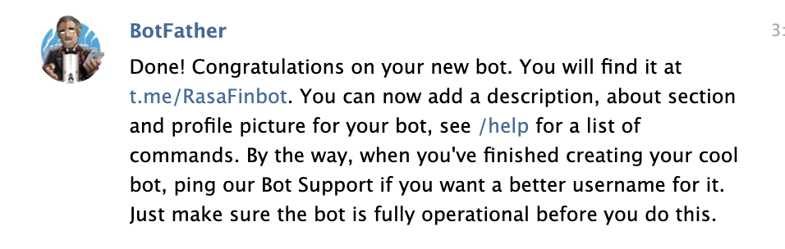
Finish Deployment
Get credentials from Telegram
Before you can connect your assistant to Telegram, you need to register your bot with Telegram and get an API token and username.
Go to Bot Father on Telegram and type /newbot
Follow the prompts to register your bot and get your API token and username
💡 Tip: When registering your bot, the name is displayed in contact details. The username is a short name used in mentions and must end in bot.

Slide 26
FINISH DEPLOYMENT
Action Server, Duckling, Telegram
Set 5 environment variables:
export ACTION_SERVER_IMAGE="karenwhite/dayfourdemo"
export ACTION_SERVER_TAG="version-0.3"
export ENABLE_DUCKLING="True"
export RASA_VERSION="1.10.0"
export ADDITIONAL_CHANNEL_CREDENTIALS="telegram.access_token='<your token>',telegram.verify='username',telegram.webhook_url='https://<yourdomain>.com/webhooks/telegram/webhook/'"
Run the one-line deploy script to apply the environment variables
curl -s get-rasa-x.rasa.com | sudo -E bash

Slide 27
Finish Deployment
Checking the status of your cluster
kubectl get pods | Lists the pods running in the k8s cluster, along with status
kubectl logs <service name> example: kubectl logs rasa-app-55b866cd99-k6nqp | List the logs for a single pod, for example, the action server

Slide 28
Finish Deployment
Talk to your bot on Telegram!
Visit https://web.telegram.org/#/im?p=@your_bot_name and test your new messaging channel!

Slide 29
Rasa X Tour

Slide 30
Rasa X Tour
Rasa X turns conversations into training data
Review Conversations
See what users are saying to your bot
Manage Training Data
Annotate training data and add new examples
🤖
💬
Messaging channels
Share your bot
Conversations
Rasa X
Conversations
Review 👁️‍🗨️ Annotate ✏️ Improve 💪

Slide 31
Rasa X Tour
Real Conversations > Synthetic Data
During development, training data is created by:
Writing down hypothetical conversations and training examples
Studying existing chat transcripts or knowledge bases
Consulting subject matter experts
That’s a great start, but all of those scenarios are based on human:human conversations.
Human:bot conversations have different patterns - users say different things when they are talking to a bot.
The best training data is generated from the assistant’s actual conversations

Slide 32
Development Stages
Conversation Driven Development (CDD)
The challenge
When developing assistants, it’s impossible to anticipate all of the things your users might say.
The approach
A user-centric process: listening to your users and using those insights to improve your AI assistant.
Principles
Prototype, Read, Annotate, Test, Track, Fix
Blog post: Conversation-Driven Development

Slide 33
Rasa X Tour
Yesterday we shared a link to test the Financial Demo Bot….
Let’s see how the assistant did, and walk through how to review conversations in Rasa X!

Slide 34
GIVE TO USERS ASAP
Wow. It struggled. Assistants always do in the beginning
You can’t anticipate how users will interact with your assistant
Expect your assistant to make mistakes when you first share it with users, no matter how much you design
However, you can improve your ability to expect the unexpected by learning from real data
Take home message: share your assistant with users as soon as possible

Slide 35
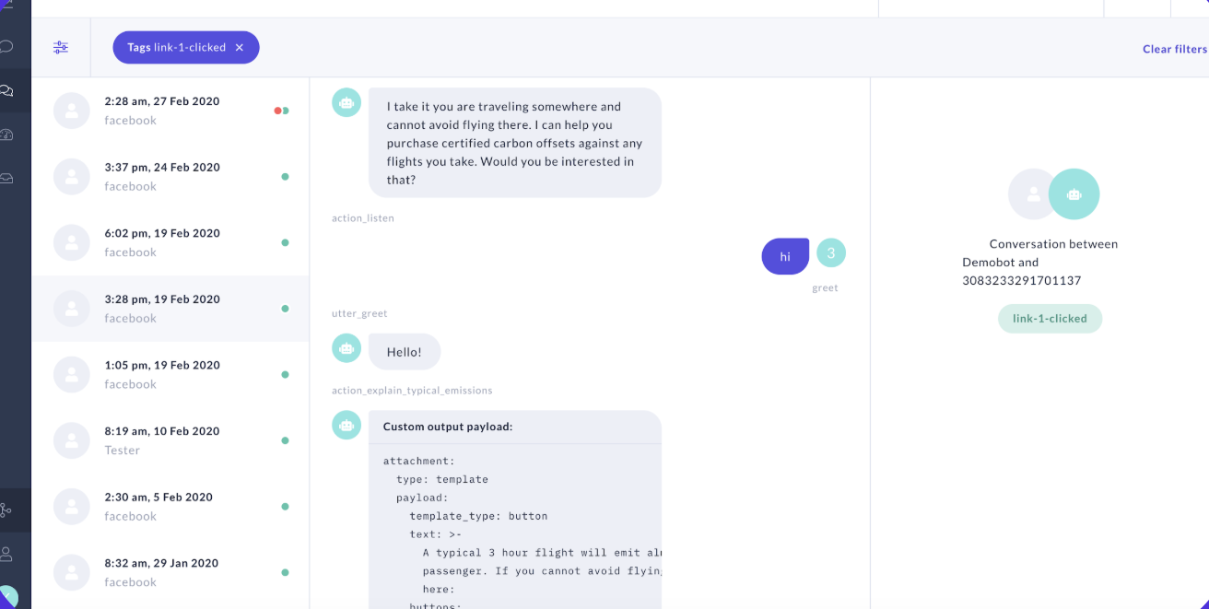
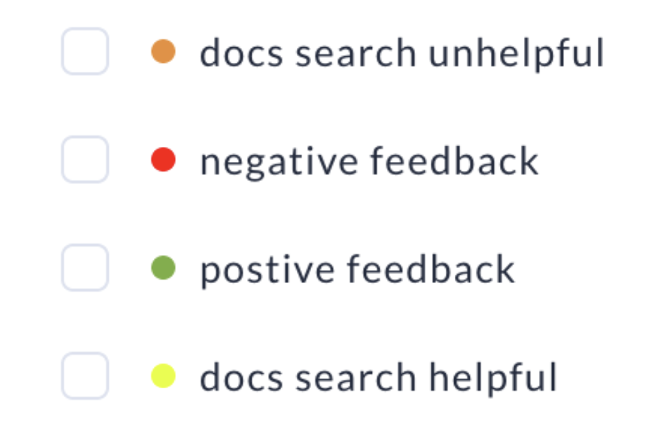
REVIEW CONVERSATIONS
Drive your development based on feedback from users
Track user actions and success rates using tags
Tags can be applied via API or in the UI
Review conversations and see where they fail
Use feedback to adjust flows and response templates, improve accuracy, or prioritize feature requests
Notes:
Demo tagging conversations

Slide 36
Development workflow

Slide 37
Dev Workflow
How Rasa X fits into your development workflow
Through the Rasa X UI, you can edit certain files:
nlu.md - add and annotate new training examples and intents, map synonyms
stories.md - add new stories to training data
domain.yml - edit file, add/edit response templates
config.yml - edit pipeline configuration
Rasa X isn’t meant to replace development that you do locally. For example, custom actions aren’t exposed in Rasa X and should be updated in your text editor.

Slide 38
Dev Workflow
What types of changes should you make in Rasa X vs developing locally?
Rasa X
Everyday training data maintenance:
Reviewing conversations
Adding, annotating, correcting training examples
Adding new test cases
Edit response templates
Tagging and sorting conversations
Local Text Editor
Bigger changes, like adding a new intent
Updates to custom actions, like changing a form’s behavior

Slide 39
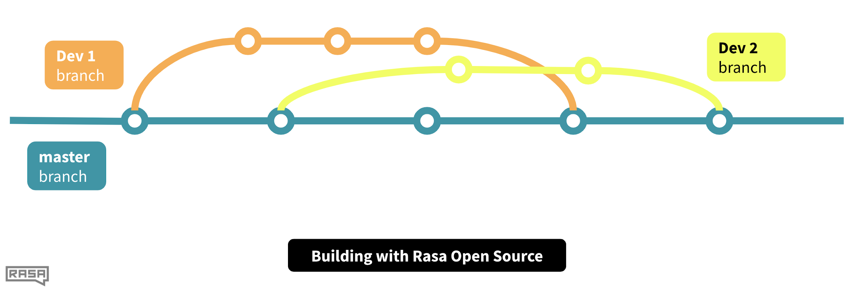
Dev Workflow
Rasa X is like another development branch….

Slide 40
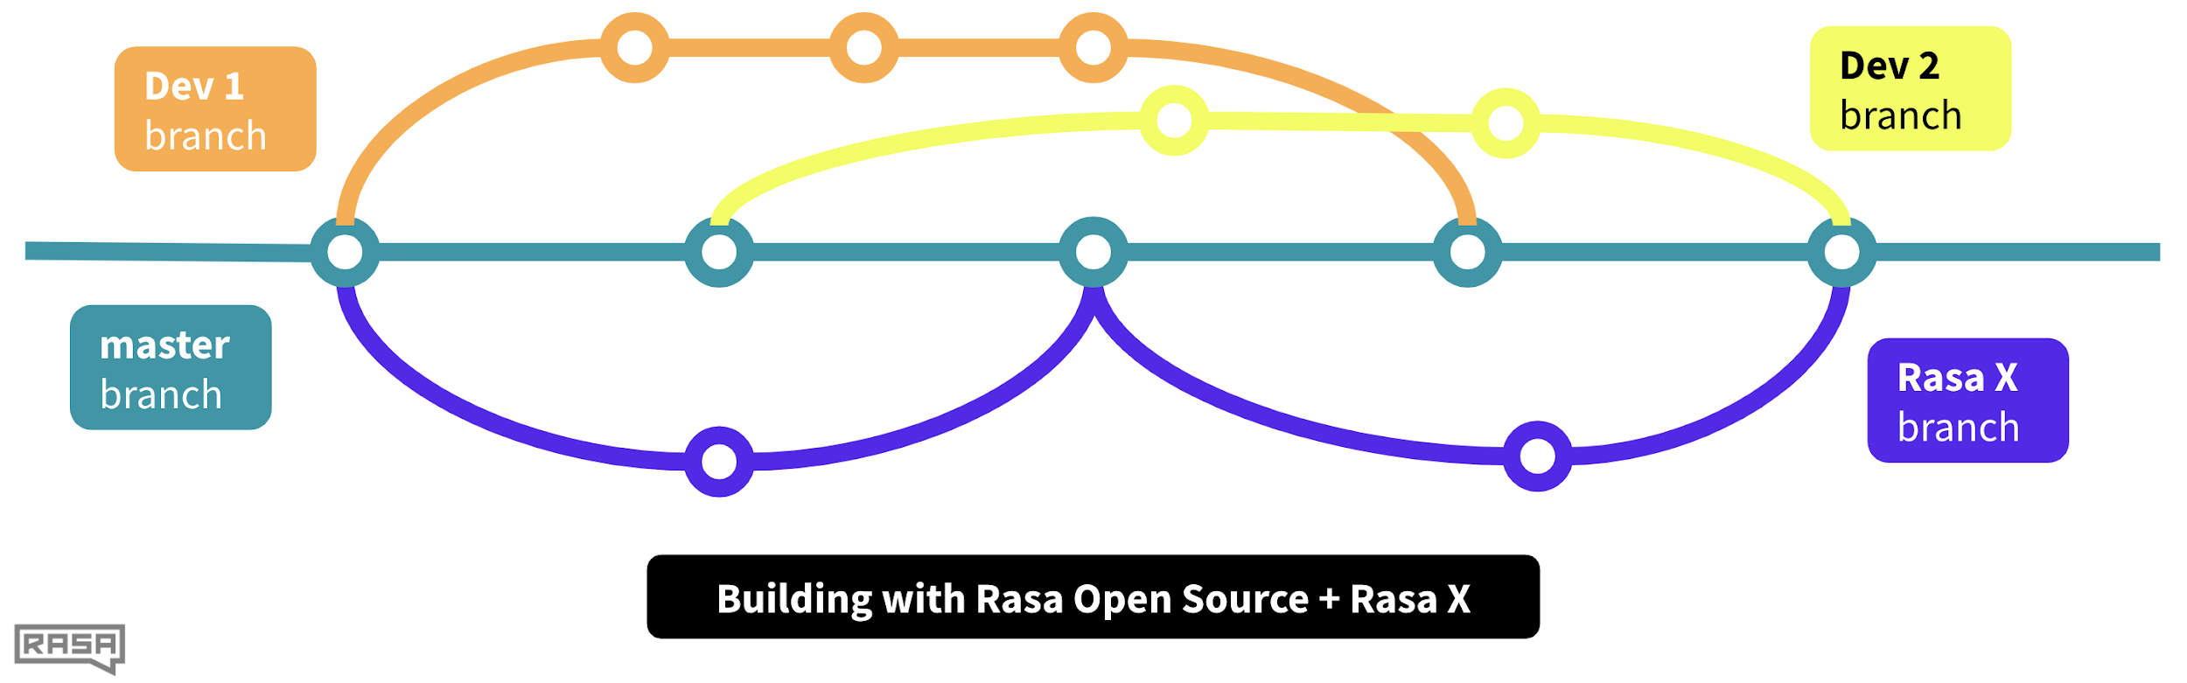
Dev Workflow
Rasa X is like another development branch….

Slide 41
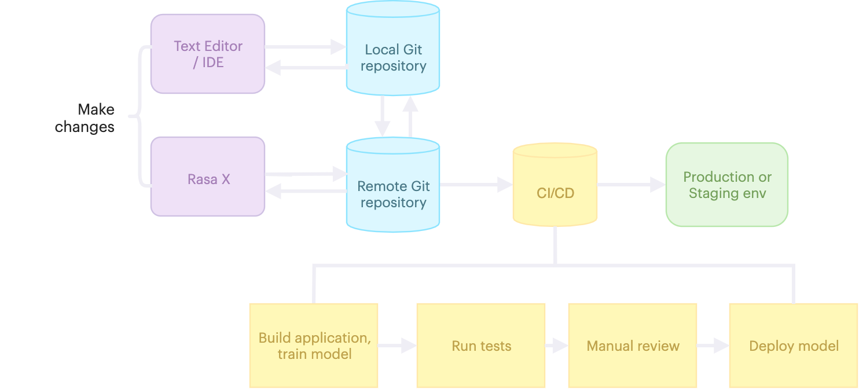
DEVELOPMENT WORKFLOW
End-to-end workflow for managing assistant updates

Slide 42
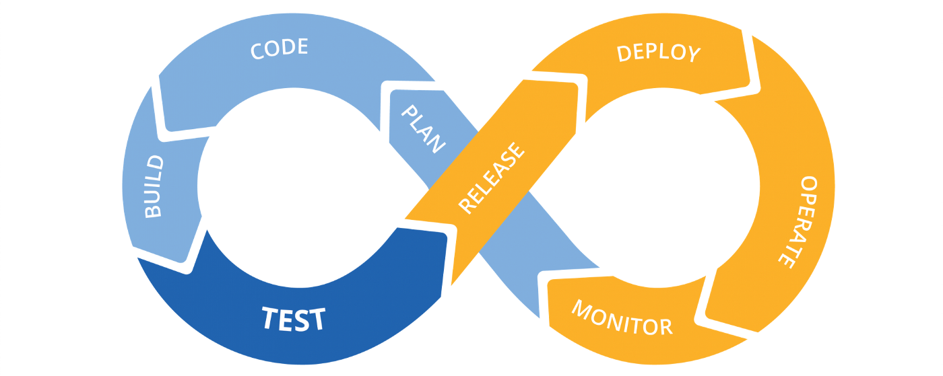
Dev Workflows
Continuous Integration/Continuous Deployment
What?
Instead of pushing periodic, major releases, CI/CD systems encourage small updates to be released to production all the time. The process of moving code from version control (GitHub) to production is fully or partially automated and tests are often run along the way.
Why?
Small releases reduce the risk of introducing bugs, because it’s easier to untangle potential problems. CI/CD workflows also get updates into users’ hands faster, resulting in a shorter feedback-to-product cycle.
Image Credit

Slide 43
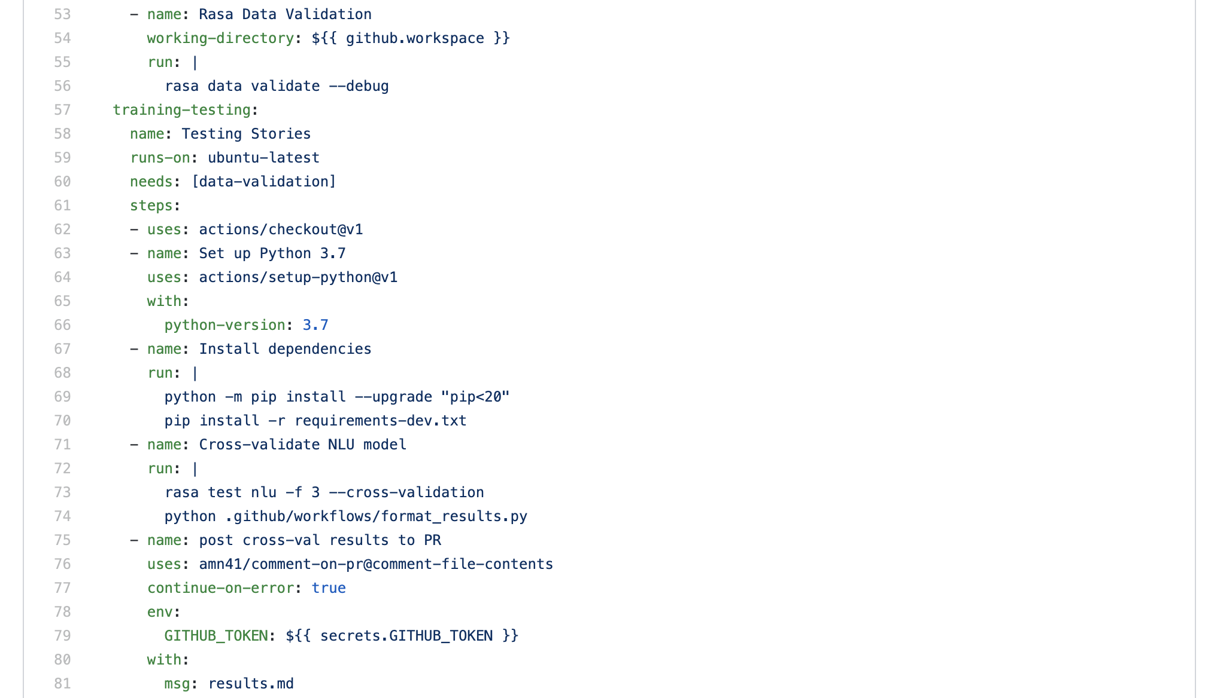
DEVELOPMENT WORKFLOW
CI/CD lets you automate testing for your assistant
Validate data to check for mistakes
Test NLU model
Print results to a pull request
Link to full example

Slide 44
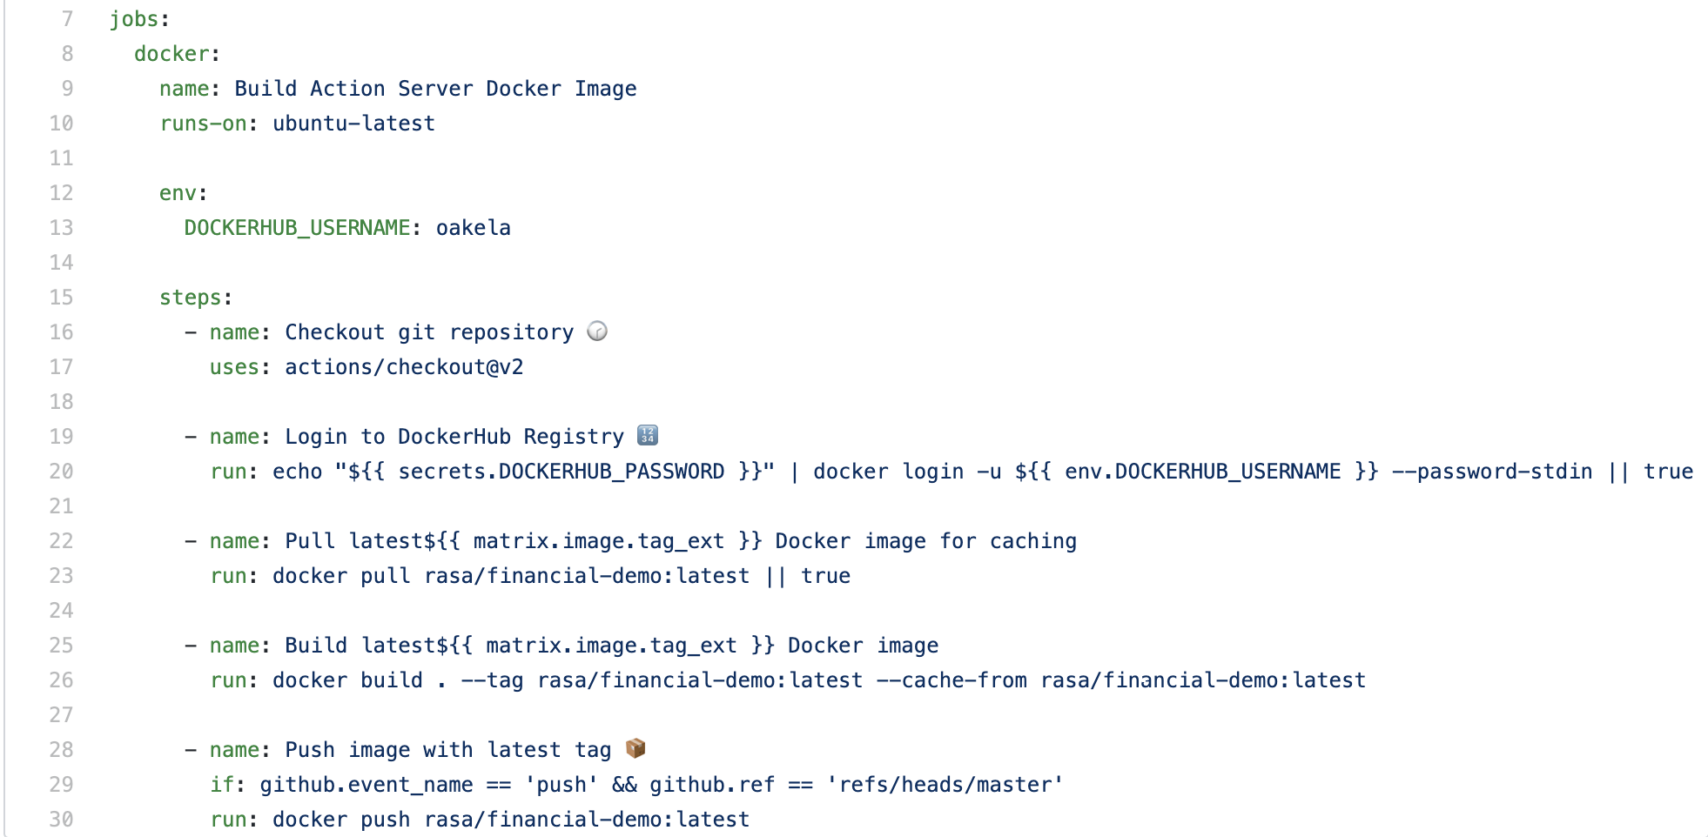
DEVELOPMENT WORKFLOW
After testing, CI/CD lets you automate the process of releasing to production
Build and push latest version of Action Server image to DockerHub
Link to full example

Slide 45
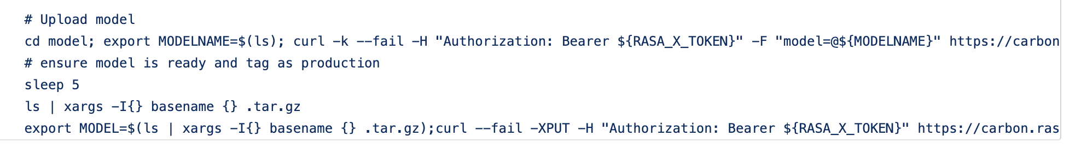
Development Workflows
Automatically upload the tested model and make it active
Link to full example
cURL call to Rasa X API to upload model

Slide 46
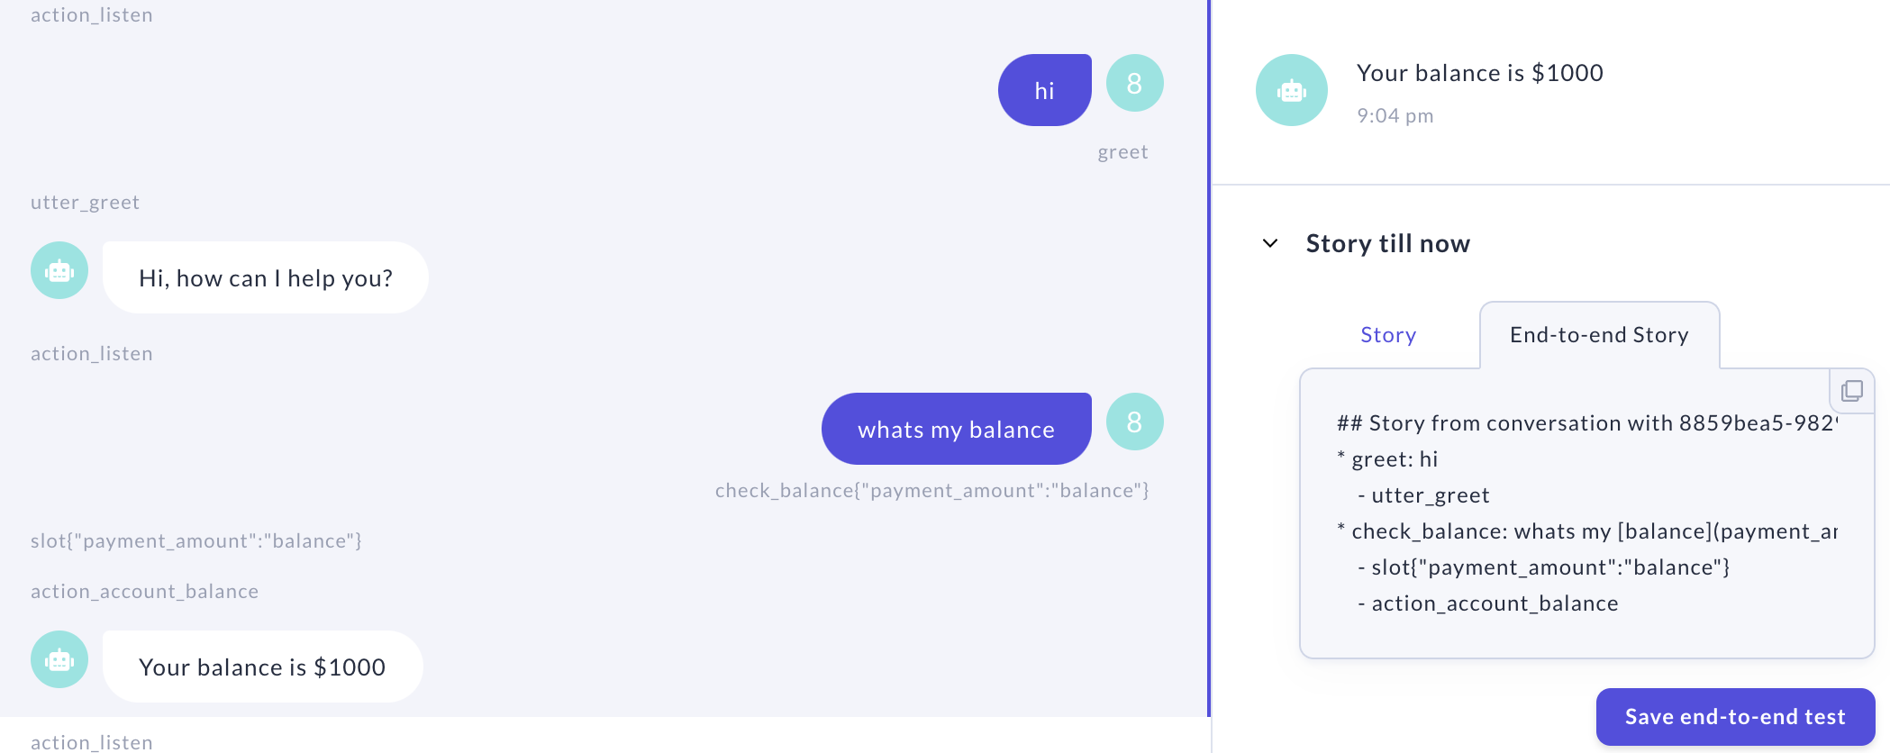
DEVELOPMENT WORKFLOW
Use Rasa X to build an end-to-end test set from real conversations
Turn real conversations into end-to-end tests using Rasa X
Collect a sample of the true distribution of real conversations
Run them as part of an automated testing pipeline
Notes:
Demo committing a change to GitHub

Slide 47
Development Stages
Notes:
Walk through

Slide 48
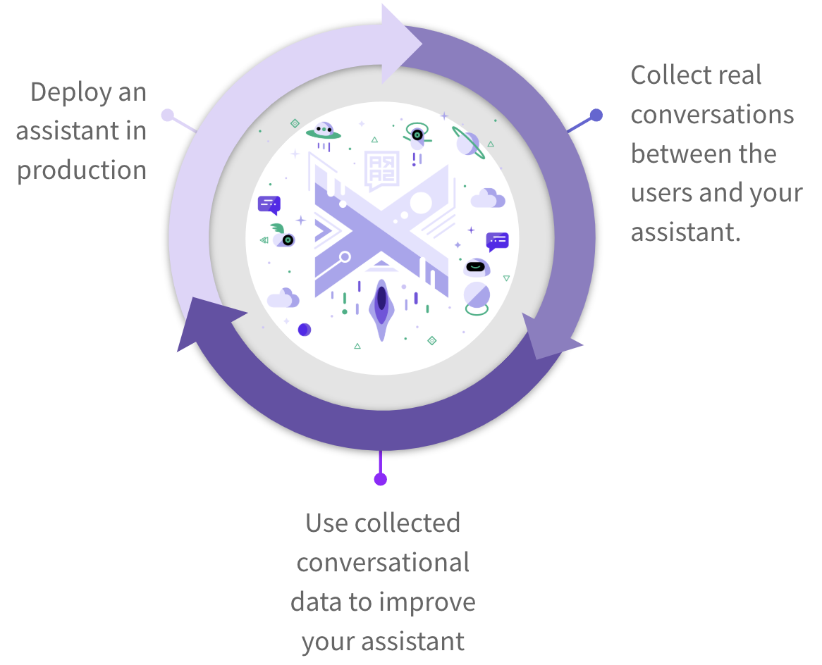

THE APPROACH
Continually improve your assistant using Rasa X
Ensure your new assistant passes tests using continuous integration (CI) and redeploy it to users using continuous deployment (CD)
Collect conversations between users and your assistant
Review conversations and improve your assistant based on what you learn

Slide 49


THE APPROACH
The path to a contextual assistant
No iterations
Quality of assistant
Rasa Open Source (Local)
Rasa X (Server)

Slide 50
THE APPROACH
The path to a contextual assistant
Quality of assistant
Rasa Open Source (Local)
Rasa X (Server)

Slide 51
THE APPROACH
The path to a contextual assistant
Quality of assistant
Rasa Open Source (Local)
Rasa X (Server)

Slide 52
THE APPROACH
The path to a contextual assistant
Quality of assistant
Rasa Open Source (Local)
Rasa X (Server)

Slide 53
THE APPROACH
The path to a contextual assistant
Quality of assistant
Rasa Open Source (Local)
Rasa X (Server)

Slide 54
THE APPROACH
The path to a contextual assistant
Quality of assistant
Rasa Open Source (Local)
Rasa X (Server)

Slide 55
THE APPROACH
The path to a contextual assistant
Quality of assistant
Rasa Open Source (Local)
Rasa X (Server)

Slide 56
THE APPROACH
The path to a contextual assistant
Quality of assistant
Rasa Open Source (Local)
Rasa X (Server)

Slide 57
THE APPROACH
The path to a contextual assistant
A few iterations
Quality of assistant
Rasa Open Source (Local)
Rasa X (Server)

Slide 58
THE APPROACH
The path to a contextual assistant
Quality of assistant
Rasa Open Source (Local)
Rasa X (Server)

Slide 59
THE APPROACH
The path to a contextual assistant
Quality of assistant
Rasa Open Source (Local)
Rasa X (Server)

Slide 60
THE APPROACH
The path to a contextual assistant
Quality of assistant
Rasa Open Source (Local)
Rasa X (Server)

Slide 61
THE APPROACH
The path to a contextual assistant
Quality of assistant
Rasa Open Source (Local)
Rasa X (Server)

Slide 62
THE APPROACH
The path to a contextual assistant
Quality of assistant
Rasa Open Source (Local)
Rasa X (Server)

Slide 63
THE APPROACH
The path to a contextual assistant
Quality of assistant
Rasa Open Source (Local)
Rasa X (Server)

Slide 64
THE APPROACH
The path to a contextual assistant
Many iterations
Quality of assistant
Rasa Open Source (Local)
Rasa X (Server)

Slide 65
THE APPROACH
The path to a contextual assistant
Quality of assistant
Rasa Open Source (Local)
Rasa X (Server)

Slide 66
THE APPROACH
The path to a contextual assistant
Quality of assistant
Rasa Open Source (Local)
Rasa X (Server)

Slide 67
THE APPROACH
The path to a contextual assistant
Quality of assistant
Rasa Open Source (Local)
Rasa X (Server)

Slide 68
THE APPROACH
The path to a contextual assistant
Quality of assistant
Rasa Open Source (Local)
Rasa X (Server)

Slide 69
THE APPROACH
The path to a contextual assistant
A lot of iterations
Quality of assistant
Rasa Open Source (Local)
Rasa X (Server)

Slide 70
Build a minimum viable assistant with Rasa Open Source + improve it using Rasa X
Talk to your bot
Build minimum viable assistant
Improve by talking to the assistant
Improve using conversations with test users
Improve using conversations with real users
Quality of assistant
Rasa Open Source is an open source framework for natural language understanding, dialogue management, and integrations.
Rasa Open Source (Local)
Rasa X is a toolset used to improve a contextual assistant built using Rasa Open Source.
Rasa X (Server)
Notes:
Don’t use Sara / use financial demo

Slide 71
Build a minimum viable assistant with Rasa Open Source + improve it using Rasa X
Share your bot
Build minimum viable assistant
Improve by talking to the assistant
Improve using conversations with test users
Improve using conversations with real users
Quality of assistant
Rasa Open Source is an open source framework for natural language understanding, dialogue management, and integrations.
Rasa Open Source (Local)
Rasa X is a toolset used to improve a contextual assistant built using Rasa Open Source.
Rasa X (Server)

Slide 72
Build a minimum viable assistant with Rasa Open Source + improve it using Rasa X
Real users on Telegram
Build minimum viable assistant
Improve by talking to the assistant
Improve using conversations with test users
Improve using conversations with real users
Quality of assistant
Rasa Open Source is an open source framework for natural language understanding, dialogue management, and integrations.
Rasa Open Source (Local)
Rasa X is a toolset used to improve a contextual assistant built using Rasa Open Source.
Rasa X (Server)

Slide 73
What’s Next?

Slide 74

NEXT STEPS
Get people to chat with your assistant and keep improving it!
Where to go from here?
Look at conversations and ask: how does your assistant struggle?
Learn how to solve problem from Rasa Docs and Community Forum
Improve assistant
Test and deploy your update
Repeat 😎

Slide 75
RASA CERTIFICATION WORKSHOP
Looking forward to tomorrow
Day 1: Setting things up
Day 2: Deep dive into NLU and dialogue management with Rasa Open Source
Day 3: Adding custom actions and implementing forms
Day 4: Deploying and improving your assistant using Rasa X
Day 5: Recap and certification
Presubmit your questions for the Q&A panel! https://forms.gle/RNbpr6Uv9q7B5Nxj9

Slide 76
Questions

